Slide 1

Home Loan Approval Report
DEEPANHSU SINGH

Slide 2
INTRODUCTION
This report presents an exploratory data analysis (EDA) of a home loan approval dataset. The analysis focuses on understanding the dataset's structure, identifying patterns and trends, and creating meaningful visualizations to communicate findings.

Slide 3
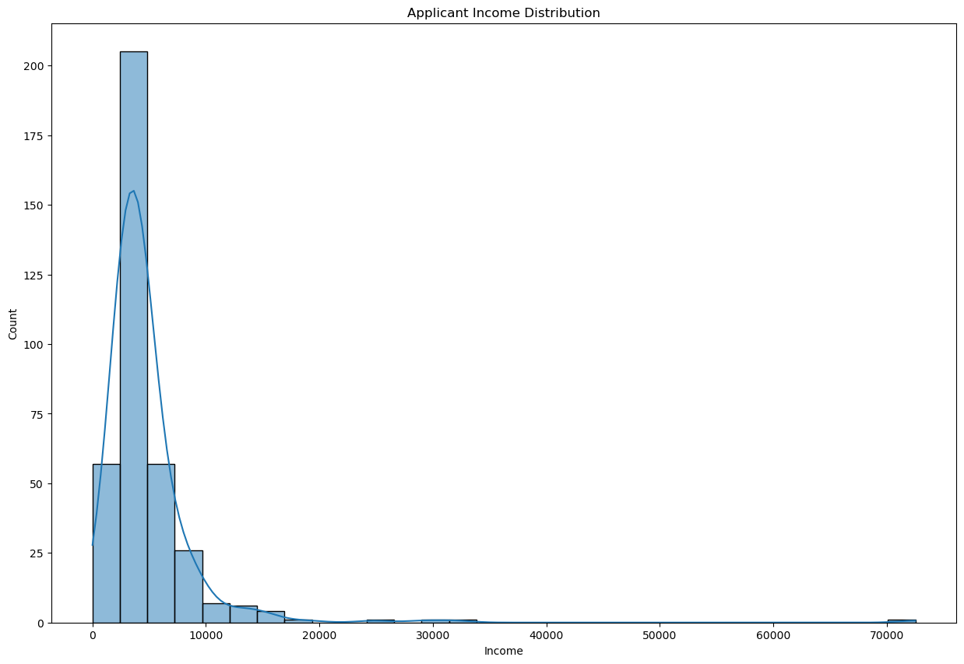
Univariate Analysis
Right-skewed with most incomes between 1,500-8,000
Several high-income outliers above 30,000

Slide 4
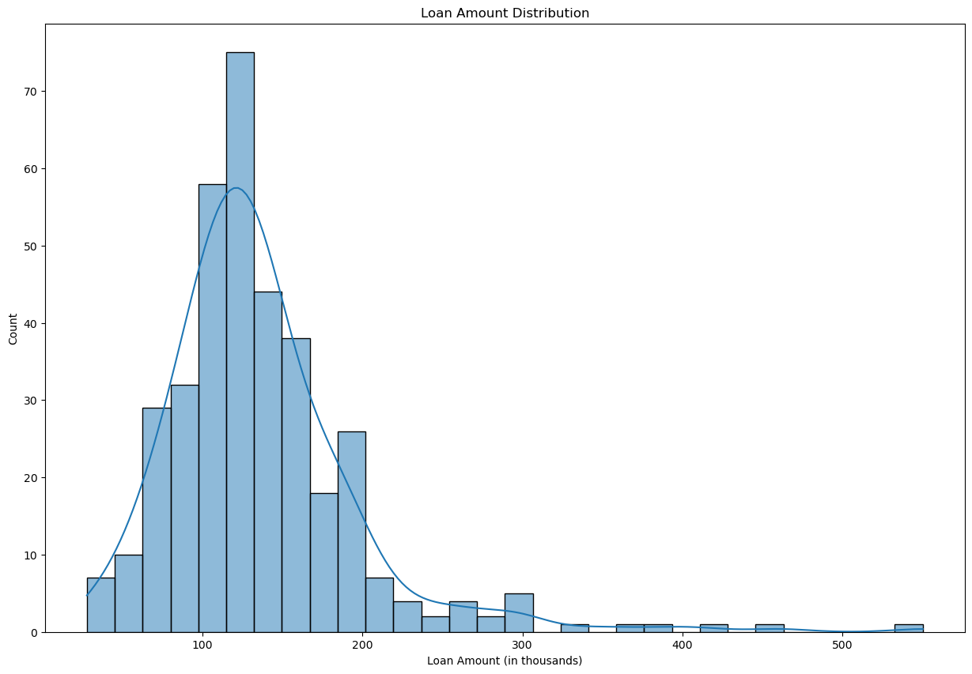
Most loans between 50-200
Few very large loans above 400

Slide 5
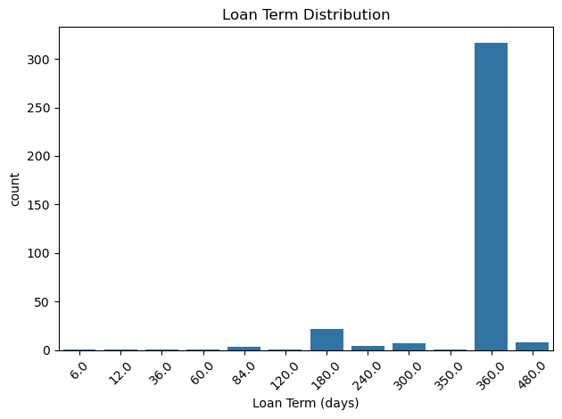
84% of loans have 360-day terms
Some shorter terms (180, 120 days)

Slide 6
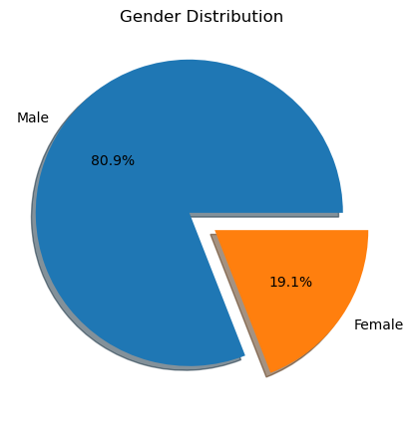
80.9% Male applicants
19.1% Female

Slide 7
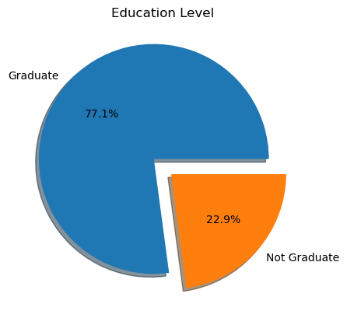
77.1% Graduate
22.9% Not Graduate

Slide 8
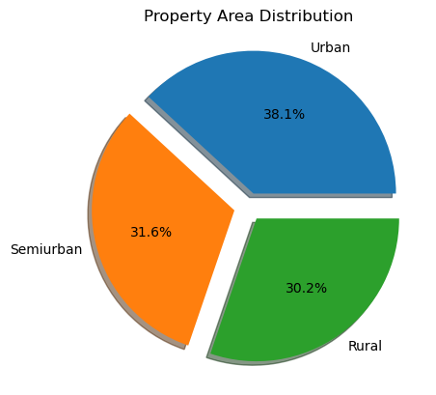
38.1% Are Urban
31.6% Are Semiurban
30.2% Are Rural

Slide 9
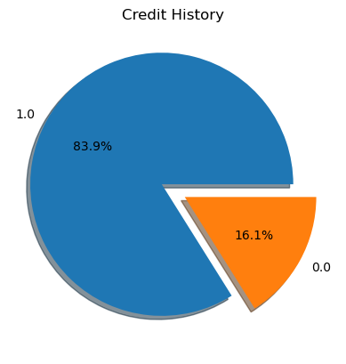
83.9% of applicants have good credit histroy
16.1% does not

Slide 10
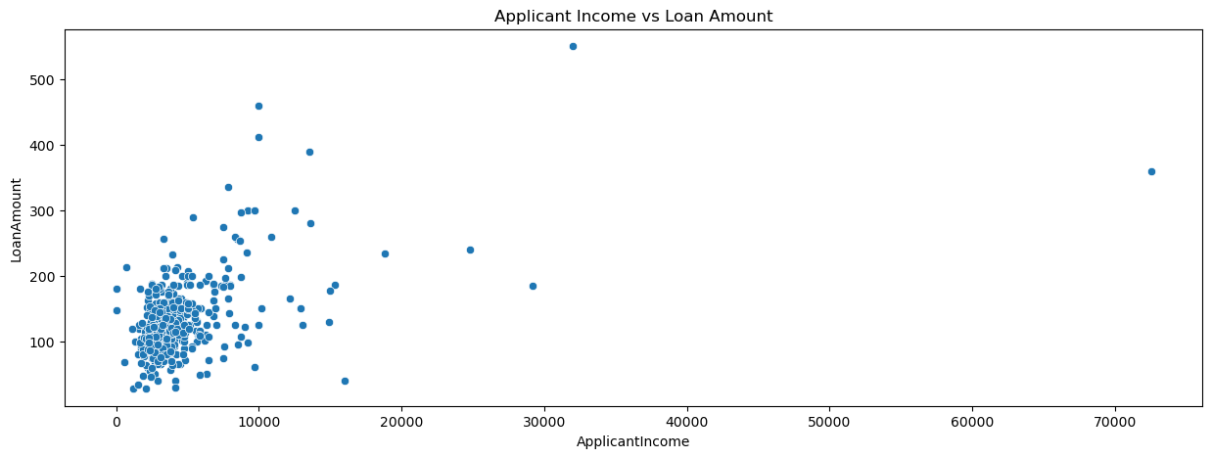
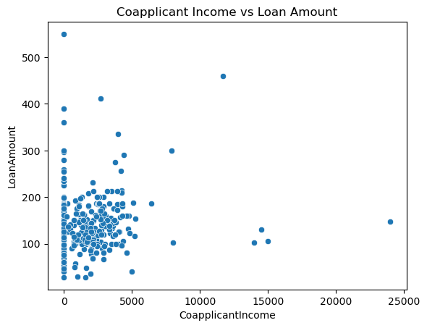
Bivariate Analysis
Positive correlation between applicant income and loan amount
Higher income applicants tend to request larger loans

Slide 11
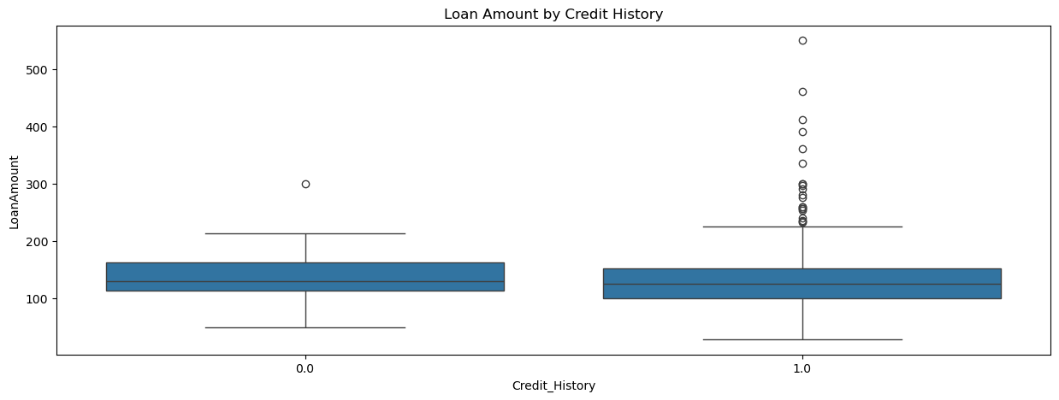
Applicants with good credit history (1) tend to get larger loans
Few loans approved for applicants with poor credit history

Slide 12
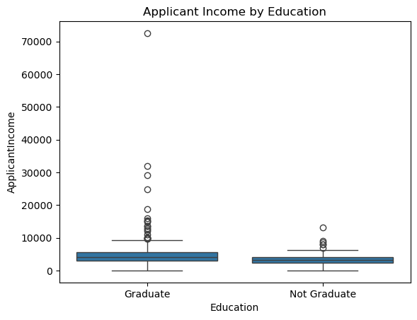
Graduates have slightly higher median incomes than non-graduates

Slide 13
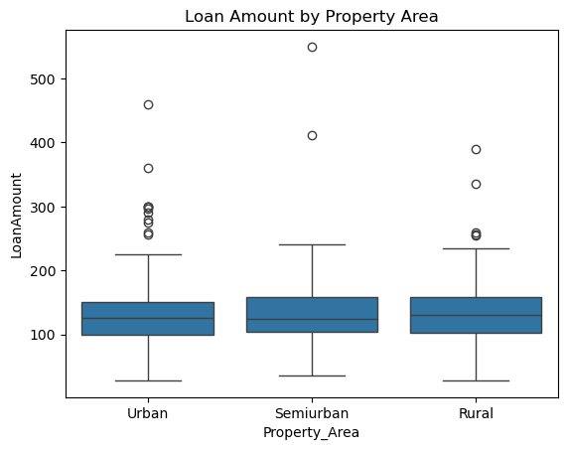
Urban took slightly higher loan more than respect to other

Slide 14
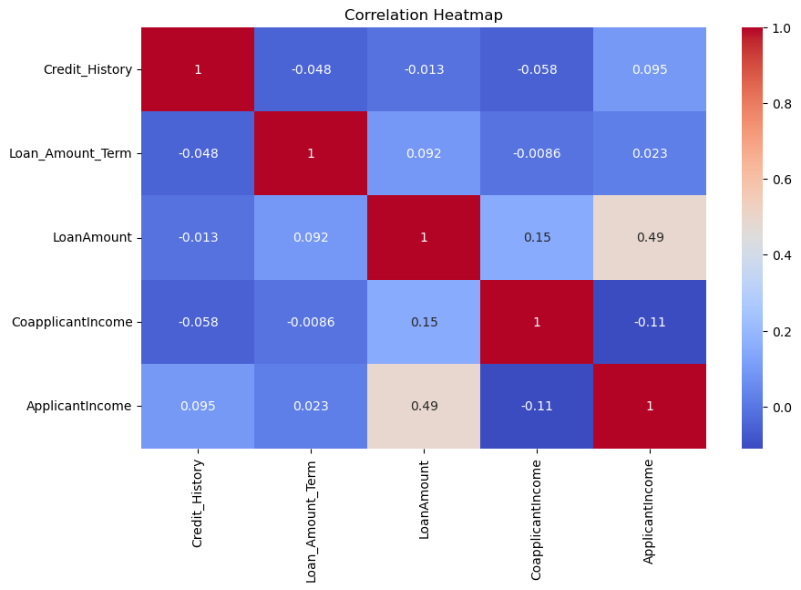
Multivarite Analysis
Strongest correlation between ApplicantIncome and LoanAmount (0.49)
Moderate correlation between LoanAmount and CoapplicantIncome (0.15)
Credit History shows weak correlation with other variables

Slide 15
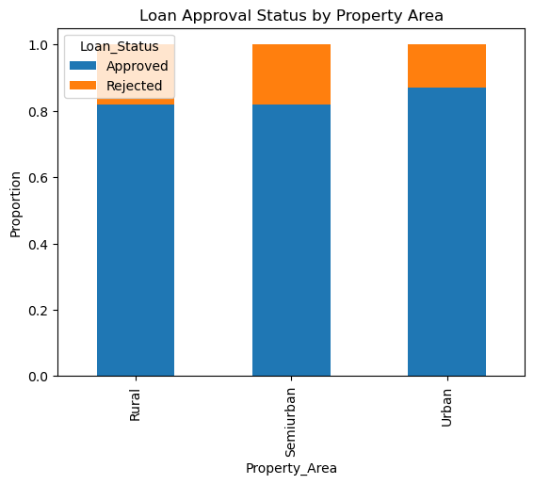
Semiurban areas have the highest approval rates
Rural areas have slightly higher rejection rates

Slide 16
Key findings
Demographic Patterns:
Most applicants are married male graduates
Applicants typically have 0-2 dependents
2. Income and Loans:
Median loan amount is 125,000 with most between 100-200,000
Income shows right-skewed distribution with some extreme outliers
3. Approval Factors:
Credit history is a significant factor in approval
Property location affects approval rates (Semiurban > Urban > Rural)

